Slide 1




Rare Variant Analysis and Exome-wide Association Studies (ExWAS) of Hearing Loss in the Penn Medicine BioBank (PMBB)
Elena Sretenović¹, Nicole Palmiero¹, Andre Rico¹, Douglas J Epstein¹, Molly A Hall¹
1. Department of Genetics, Perelman School of Medicine, University of Pennsylvania

Slide 2
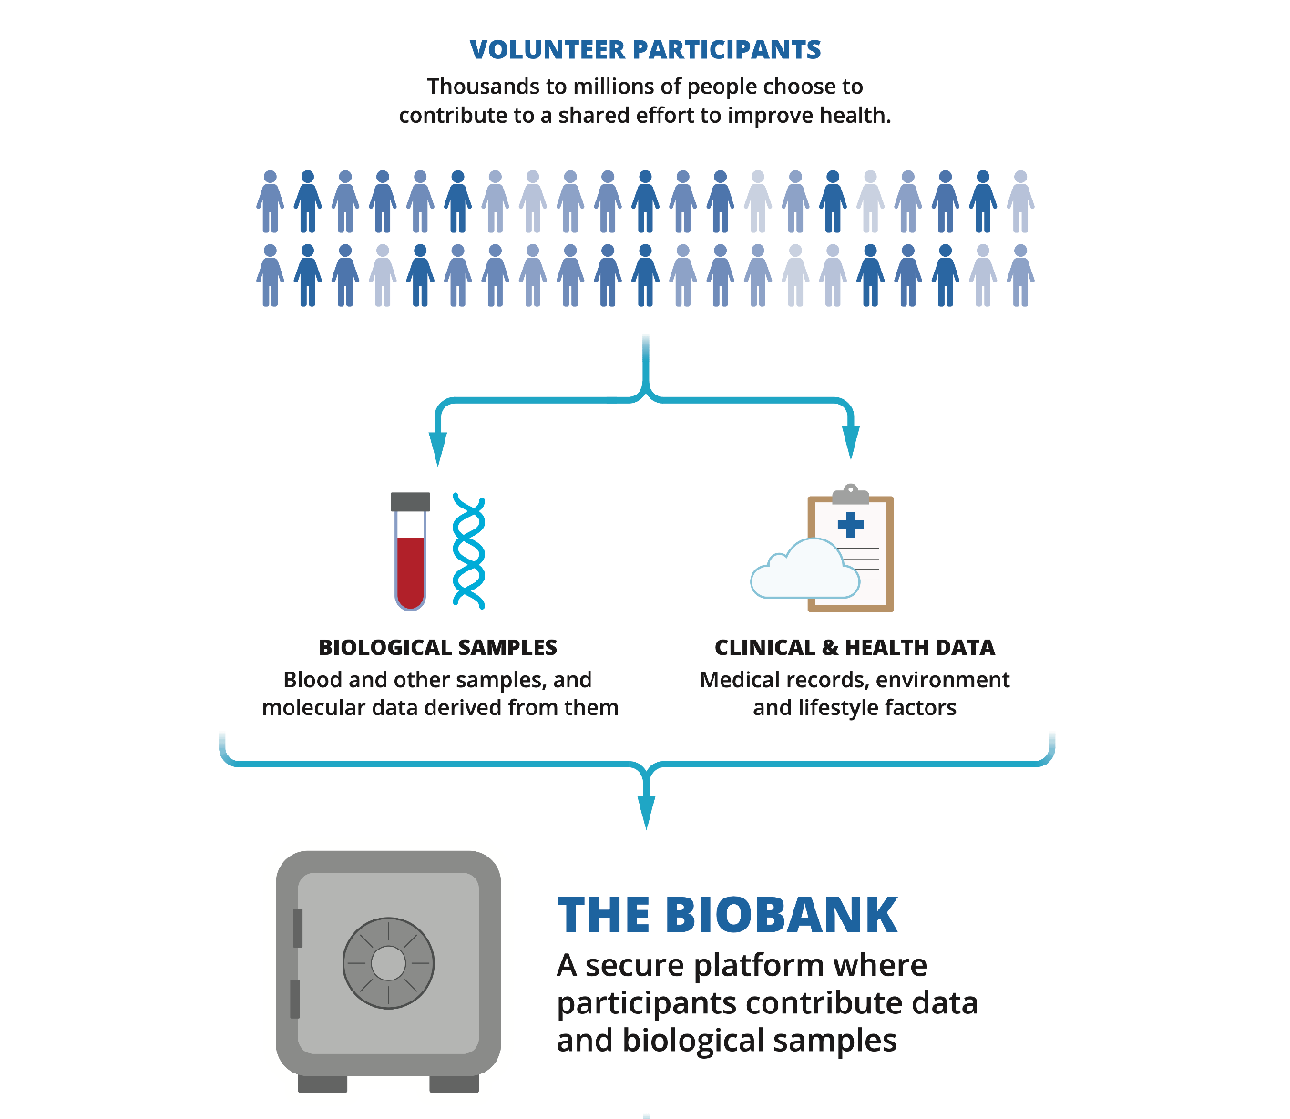
Background
Adult-onset hearing loss is one of the most common sensory disorders worldwide and can arise from genetic factors
Different genetic architecture compared to congenital hearing loss
Biobank Datasets
  Exome sequencing
  Electronic health record (EHR)

Slide 3



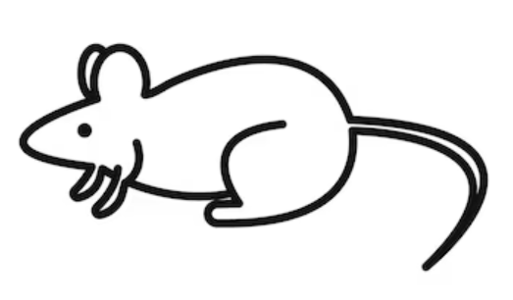
Background
Penn Medicine BioBank (PMBB)
Previous analyses identified ZNF175 as a candidate hearing loss gene¹
  strong association with tinnitus
  suggestive association with hearing loss.
Functional studies in mice further support ZNF175’s role as a hearing loss gene
  disruption of the mouse ortholog (Zfp719) → hearing loss in mice.
ZNF175
Zfp719
1. Park J, et al. Nature Medicine. 2021;27:66–72.

Slide 4
Goals
1.
2.
Evaluate the association between ZNF175 and hearing loss in PMBB v4
Search for novel hearing loss genes
Common Variants
Rare Variants
Common Variants
Rare Variants

Slide 5
Methods
ExWAS
Exome wide association study
Look at common variants
Rare Variant Analysis
Aggregate rare coding variants within genes
Look for associations that may not be detected through single-variant testing of common variants.

Slide 6
Methods
Phenotype Definition: H90, H91, H93
Quality Control and Minor Allele Filtering
Covariates: Covariates age, age², sex, and principal components (PCs) were included for adjustment
Penn Medicine BioBank v4
ExWAS
Genotype Call Rate > 0.99
SAIGE
Data Visualization
MAF > 0.01
Variants
SAIGE-GENE
Rare Variant Gene Burden
Genotype Call Rate > 0.99
MAF =< 0.01, 0.001, 0.0001
All Ancestry
Cases
Controls
Participants
African Ancestry
Cases
Controls
European Ancestry
Cases
Controls

Slide 7
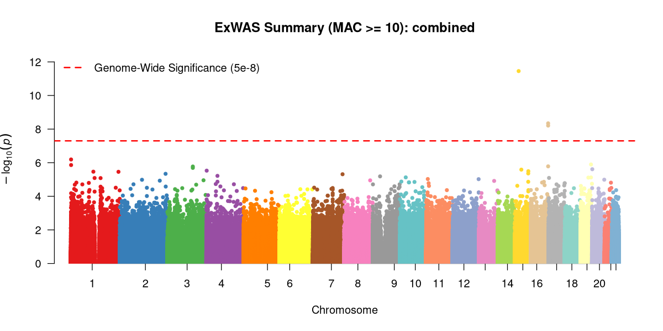
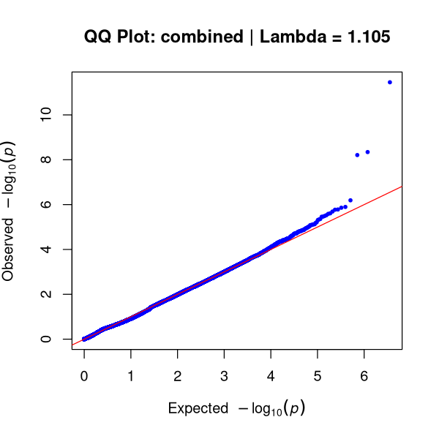
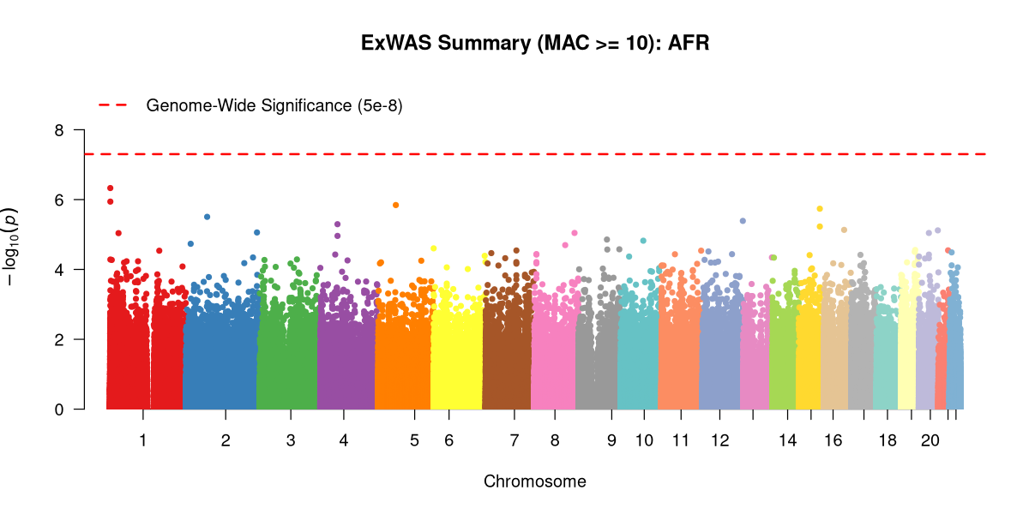
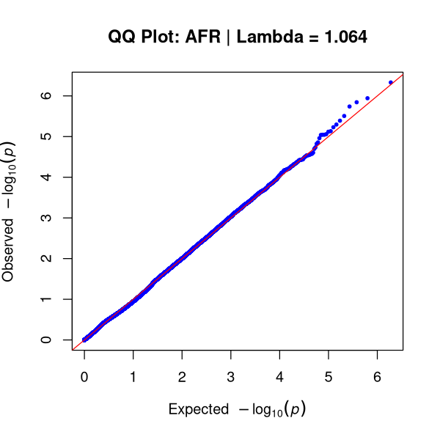

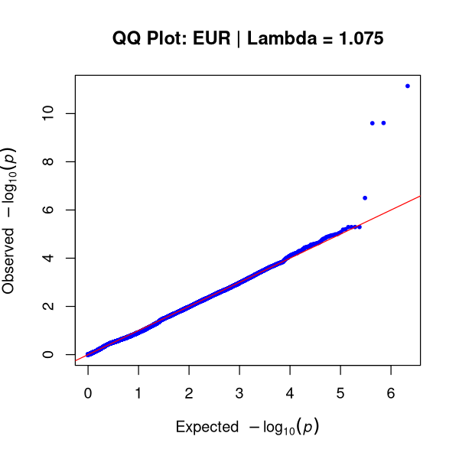
Results: ExWAS
Exome Wide Significant Results Total: 6 Unique: 3
Gene | Variant | Cohort | P-Value
KNL1 | chr15:40611486:A:G | Combined | 3.51e-12
KNL1 | chr15:40611486:A:G | EUR | 7.21e-12
ZFPM1 | chr16:88533289:A:C | EUR | 2.46e-10
ZFPM1 | chr16:88533290:G:C | EUR | 2.52e-10
ZFPM1 | chr16:88533290:G:C | Combined | 4.54e-9
ZFPM1 | chr16:88533289:A:C | Combined | 6.18e-9
Combined
AFR
EUR

Slide 8
Results: Rare Variant Gene Burden
Hearing Loss, Bonferroni Significant
Gene | Ancestry | Mask | MAF | Test | Raw P | Bonferroni P
AARS1 | AFR | ALL | 0.01 | Burden (β = 0.153) | 1.94 × 10⁻⁶ | 0.01263
PRIMPOL | EUR | ALL | 0.001 | Burden (β = -0.372) | 1.91 × 10⁻⁶ | 0.01494
ACVR2B | Combined | ALL | 0.01 | Burden (β = 0.331) | 3.72 × 10⁻⁶ | 0.01657
TMC3-AS1 | Combined | pLOF | 0.001 | SKAT | 3.20 × 10⁻⁶ | 0.02299
IGSF9 | AFR | pLOF+pDM | 0.001 | Burden (β = 1.385) | 4.91 × 10⁻⁶ | 0.04181

Slide 9
Results: Rare Variant Gene Burden
Tinnitus, Bonferroni Significant
Gene | Ancestry | Mask | MAF | Test | Raw P | Bonferroni P
OR2M4 | EUR | ALL | 0.01 | SKAT | 4.07 × 10⁻⁶ | 0.02224
OR2M4 | EUR | ALL | 0.01 | Burden (β = 0.642) | 5.28 × 10⁻⁶ | 0.02885
KCNH8 | Combined | pDM | 0.01 | Burden (β = 0.677) | 6.00 × 10⁻⁶ | 0.03389
FBXL7 | EUR | ALL | 0.001 | Burden (β = 0.672) | 4.51 × 10⁻⁶ | 0.03640
AQP3 | AFR | pLOF | 0.001 | Burden (β = 3.116) | 4.57 × 10⁻⁶ | 0.03877

Slide 10
Discussion
ZNF175 did NOT meet the genome-wide single-variant threshold (5e-8) in the ExWAS and did it NOT meet the significance threshold in the rare variant analyses
None of the top hits of the ExWAS overlap with the top hits of the rare variant
ExWAS
Rare Variant Analysis
Top hits were marked as likely benign by AlphaMissense
Studying hearing loss with the PMBB requires a different approach
Top hits included genes involved in multiple pathways
  KCNH8 → codes for potassium channel (one of the top hits for tinnitus)
  AARS1 → implicated in neurological disorders (one of the top hits for hearing loss)

Slide 11
Future Directions
External Replication
  UK Biobank
  All of Us Research Program.
Functional Validation
  Investigate some of the top genes revealed in mice (just as the ZNF175 gene was investigated and supported as a candidate hearing loss gene)
Notes:
Validate the prioritized candidate variants and top genes in independent biobank cohorts

Slide 12

Thank you!
Acknowledgements
This work is supported by the following: Penn Genetics Summer Internship Program (PGSIP), University of Pennsylvania Research Trainee Affairs
Hall Lab
Nikki Palmiero
Molly Hall
Andre Rico
Epstein Lab
Doug Epstein
Staci Rakowiecki
Tingfang Chen
Sophie Shapiro

